Slide 1




Slide 2
Fine-tuning the BERT model for sentence-pairs

Slide 3

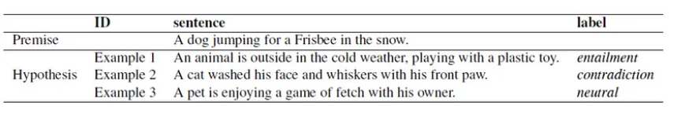
Introduction
Regression Model
Score Range
[1,-1]
Or
[1 , 5]
sentence-pair tasks such as document similarity or textual entailment, the input is two sentences
Document similarity: what degree two sentences are semantically similar or predict whether they are semantically similar.
Textual entailment: refers to the relationship between two pieces of text.
The regression model is considered to be for classification, but the last layer only contains a single unit. This is not processed by SoftMax logistic regression but normalized.

Slide 4
Load Bert as regression model
Load the Model:
from transformers import DistilBertConfig, DistilBertTokenizerFast, DistilBertForSequenceClassification
model_path='distilbert-base-uncased'
config = DistilBertConfig.from_pretrained(model_path, num_labels = 1)
tokenizer = DistilBertTokenizerFast.from_pretrained(model_path)
model = DistilBertForSequenceClassification.from_pretrained(model_path , config = config)

Slide 5
The Pipeline
Use The Semantic Textual Similarity-Benchmark or STS-B .
→ Collection of sentence pairs that have been drawn from a variety of content, such as news headlines.
→ Each pair has been annotated with a similarity score from 1 to 5.
2. Fine-tune the BERT model to predict these scores.
3. Evaluate the model using the Pearson/ Spearman correlation coefficients.

Slide 6
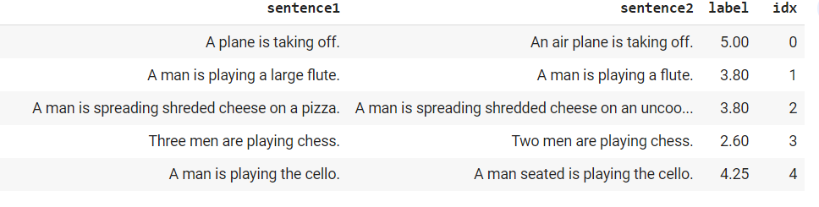
1. Prepare dataset
Load and split the dataset to :
Preview sample from the training set:
import datasets
from datasets import load_dataset
stsb_train= load_dataset('glue','stsb', split="train")
stsb_validation = load_dataset('glue','stsb', split="validation").shuffle(seed=42)
stsb_validation
Dataset({
features: ['sentence1', 'sentence2', 'label', 'idx'],
num_rows: 1500})
stsb_val= datasets.Dataset.from_dict(stsb_validation[:750])
stsb_test= datasets.Dataset.from_dict(stsb_validation[750:])
import pandas as pd
pd.DataFrame(stsb_train)

Slide 7
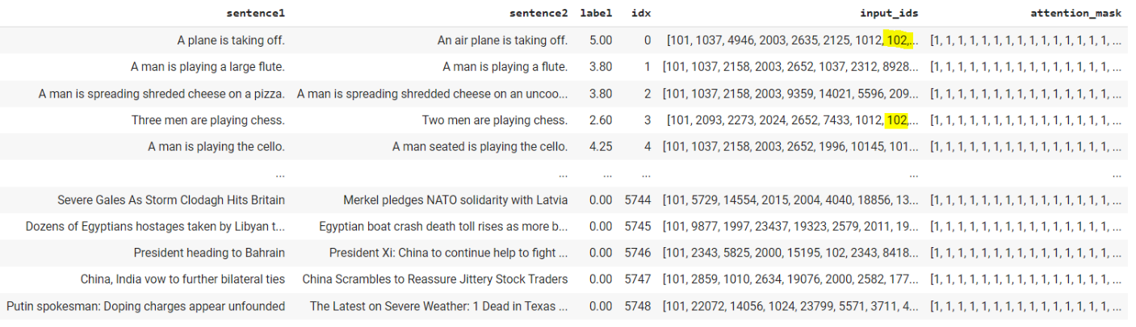
1. Prepare dataset
Tokenize datasets:
train = stsb_train.map( lambda x: tokenizer( x['sentence1'],x['sentence2'], padding=True, truncation= True), batched =True, batch_size =1000 )
val = stsb_val.map( lambda x: tokenizer( x['sentence1'],x['sentence2'], padding=True, truncation= True), batched =True, batch_size =1000 )
test =stsb_test.map( lambda x: tokenizer( x['sentence1'],x['sentence2'], padding=True, truncation= True), batched =True, batch_size =1000 )

Slide 8
2. Fine Tuning (define training arguments)
Define training argument
from transformers import TrainingArguments, Trainer
training_args = TrainingArguments(
output_dir='./stsb-model',
do_train=True,
do_eval=True,
num_train_epochs=3,
per_device_train_batch_size=32,
per_device_eval_batch_size=64,
warmup_steps=100,
weight_decay=0.01,
logging_strategy='steps',
logging_dir='./logs',
logging_steps=50,
evaluation_strategy="steps",
save_strategy="steps",
fp16=True,
load_best_model_at_end=True
)

Slide 9
2. Fine Tuning (define evaluation metric)
Pearson Correlation Coefficient and the Spearman's Rank Correlation following the common practice provided in the literature.
import numpy as np
from scipy.stats import pearsonr
from scipy.stats import spearmanr
def compute_metrics(pred):
preds = np.squeeze(pred.predictions)
return {"MSE": ((preds - pred.label_ids) **2).mean().item(),
"RMSE":(np.sqrt (( (preds - pred.label_ids) ** 2).mean())).item(),
"MAE": (np.abs(preds - pred.label_ids)).mean().item(),
"Pearson" : pearsonr(preds,pred.label_ids)[0],
"Spearman's Rank":spearmanr(preds,pred.label_ids)[0]
}

Slide 10
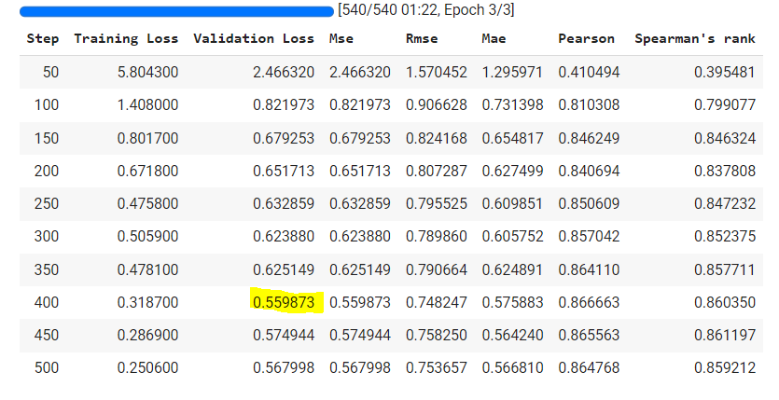
2. Fine Tuning (training the model)
Instantiate the Trainer object:
Start the training:
trainer = Trainer(
model=model,
args=training_args,
train_dataset=train,
eval_dataset = val,
compute_metrics = compute_metrics,
tokenizer=tokenizer
)
train_result = trainer.train()

Slide 11
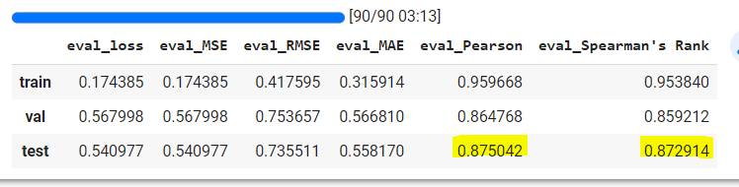
3. Evaluate the model
Evaluate the best checkpoint model:
Run the model for inference:
q =[trainer.evaluate(eval_dataset=data) for data in [train, val, test]]
pd.DataFrame(q, index=["train","val","test"]).iloc[:,:6]
s1,s2="A plane is taking off.","An air plane is taking off."
encoding = tokenizer( s1, s2, return_tensors='pt', padding=True, truncation=True, max_length=512)
input_ids = encoding['input_ids'].to(device)
attention_mask = encoding['attention_mask'].to(device)
outputs = model(input_ids, attention_mask=attention_mask)
outputs.logits.item()
4.69

Slide 12
3. Evaluate the model
Run the model for inference:
Save the model:
s1,s2="The men are playing soccer.","A man is riding a motorcycle."
0.28
model_path = "sentence-pair-regression-model"
trainer.save_model(model_path)
tokenizer.save_pretrained(model_path)

